Slide 1
Propositional Logic
Notes:
Todo:
ask Jim about examples of complex rule systems.

Slide 2
Logic and Ontologies
Large collections of facts in logic are structured in hierarchices known as ontologies

Slide 3
Knowledge-Based Agents
KB = knowledge base
  A set of sentences or facts
  e.g., a set of statements in a logic language
Inference
  Deriving new sentences from old
  e.g., using a set of logical statements to infer new ones
A simple model for reasoning
  Agent is told or perceives new evidence
    E.g., A is true
  Agent then infers new facts to add to the KB
    E.g., KB = { A -> (B OR C) }, then given A and not C we can infer that B is true
    B is now added to the KB even though it was not explicitly asserted, i.e., the agent inferred B

Slide 4
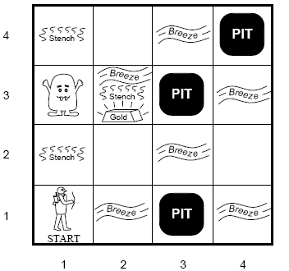
Wumpus World
Environment
  Cave of 4×4
  Agent enters in [1,1]
  16 rooms
    Wumpus: A deadly beast who kills anyone entering his room.
    Pits: Bottomless pits that will trap you forever.
    Gold

Slide 5
Wumpus World
Agents Sensors:
  Stench next to Wumpus
  Breeze next to pit
  Glitter in square with gold
  Bump when agent moves into a wall
  Scream from wumpus when killed
Agents actions
  Agent can move forward, turn left or turn right
  Shoot, one shot

Slide 6
Wumpus World
Performance measure
  +1000 for picking up gold
  -1000 got falling into pit
  -1 for each move
  -10 for using arrow

Slide 7
What is a Logic?
A language with concrete rules
  No ambiguity in representation (may be other errors!)
  Allows unambiguous communication and processing
  Very unlike natural languages e.g. English
Many ways to translate between languages
  A statement can be represented in different logics
  And perhaps differently in same logic
Expressiveness of a logic
  How much can we say in this language?
Not to be confused with logical reasoning
  Logics are languages, reasoning is a process (may use logic)

Slide 8
Syntax and Semantics
Syntax
  Rules for constructing legal sentences in the logic
  Which symbols we can use (English: letters, punctuation)
  How we are allowed to combine symbols
Semantics
  How we interpret (read) sentences in the logic
  Assigns a meaning to each sentence
Example: “All lecturers are seven foot tall”
  A valid sentence (syntax)
  And we can understand the meaning (semantics)
  This sentence happens to be false (there is a counterexample)

Slide 9
What is a logical language?
A formal language
  KB = set of sentences
Syntax
  what sentences are legal (well-formed)
  E.g., arithmetic
    X+2 >= y is a wf sentence, +x2y is not a wf sentence
Semantics
  loose meaning: the interpretation of each sentence
  More precisely:
    Defines the truth of each sentence wrt to each possible world
  e.g,
    X+2 = y is true in a world where x=7 and y =9
    X+2 = y is false in a world where x=7 and y =1
  Note: standard logic – each sentence is T of F wrt eachworld
    Fuzzy logic – allows for degrees of truth.
Notes:
Logic is like a new language, like French or mathemathical algebra.
Not as easy as CSP.
Statisticians and Economists refuse to learn.

Slide 10
Propositional logic: Syntax & Semantics
Propositional logic is the simplest logic – illustrates basic ideas
Atomic sentences = single proposition symbols
  E.g., P, Q, R
  Special cases: True = always true, False = always false
Complex sentences:
  If S is a sentence, ¬S is a sentence (negation)
  If S₁ and S₂ are sentences, S₁ ∧ S₂ is a sentence (conjunction)
  If S₁ and S₂ are sentences, S₁ ∨ S₂ is a sentence (disjunction)
  If S₁ and S₂ are sentences, S₁ ⇒ S₂ is a sentence (implication)
  If S₁ and S₂ are sentences, S₁ ⇔ S₂ is a sentence (biconditional)
A sentence is interpreted in terms of models, or possible worlds.
These are formal structures that specify a truth value for each sentence in a consistent manner.

Slide 11
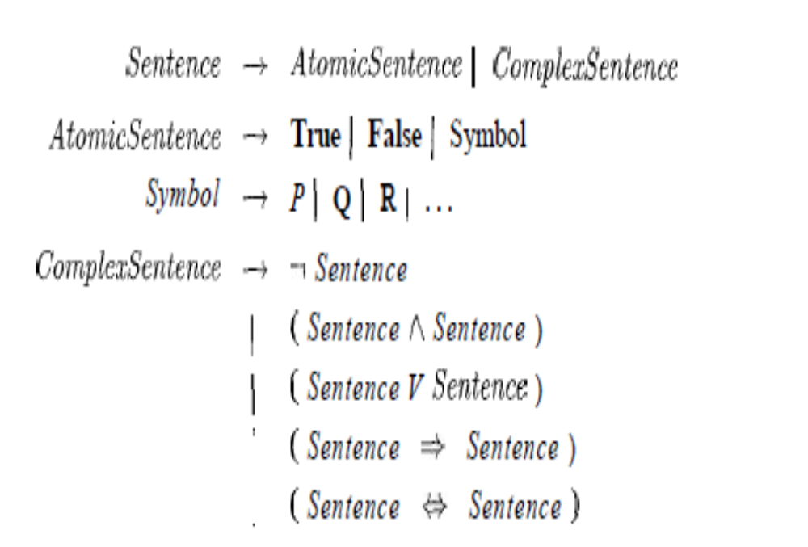
Propositional logic: Syntax

Slide 12

Wumpus world sentences
Let P_{i,j} be true if there is a pit in [i, j].
Let B_{i,j} be true if there is a breeze in [i, j].
  start: ¬ P_{1,1}
  ¬ B_{1,1}
  B_{2,1}
"Pits cause breezes in adjacent squares"
  B_{1,1} ⇔ (P_{1,2} ∨ P_{2,1})
  B_{2,1} ⇔ (P_{1,1} ∨ P_{2,2} ∨ P_{3,1})
KB can be expressed as the conjunction of all of these sentences
Note that these sentences are rather long-winded!
  E.g., breeze “rule” must be stated explicitly for each square
  First-order logic will allow us to define more general patterns.

Slide 13

Truth tables for connectives

Slide 14
Entailment
One sentence follows logically from another
α |= β
α entails sentence β if and only if β is true in all worlds where α is true.
e.g., x+y=4 |= 4=x+y
Entailment is a relationship between sentences that is based on semantics.

Slide 15
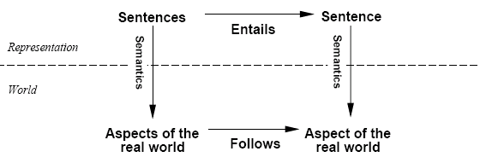
Schematic perspective
If KB is true in the real world, then any sentence α derived
from KB by a sound inference procedure is also true in the
real world.
Notes:
See also Assignment 3.

Slide 16

Logical equivalence
To manipulate logical sentences we need some rewrite rules.
Two sentences are logically equivalent iff they are true in same models: α ≡ ß iff α╞ β and β╞ α
Notes:
Another example: solve equation in 1 unknown.
Demonstrate in tarksi demo.

Slide 17



Modus Ponens
And-Elimination
Bi-conditional Elimination

Slide 18



Horn Clauses
Horn Clause = A clause with at most 1 positive literal.
e.g.
Every Horn clause can be rewritten as an implication with
a conjunction of positive literals in the premises and at most a single
positive literal as a conclusion.
e.g.
1 positive literal: definite clause
0 positive literals: Fact or integrity constraint:
e.g.
Psychologically natural: a condition implies (causes) a single fact.
The basis of logic programming (the prolog language).
SWI Prolog. Prolog and the Semantic Web. Prolog Applications
Notes:
Show Aispace demo.
In application, easy to specify rules, interchange format.
See especially “Air” application, .e.g. Boeing.

Slide 19
HOME WORK
Vishnu likes fruit banana.
Mani is a good student.
All good students have high grades.
Arjun eats Banana
Narayanan likes seeing Tamil movies.

